Slide 1
Connected Device Studio Deploy Back-end Services to Azure Service Fabric
Walker Lin
Microsoft IoT Innovation Center

Slide 2
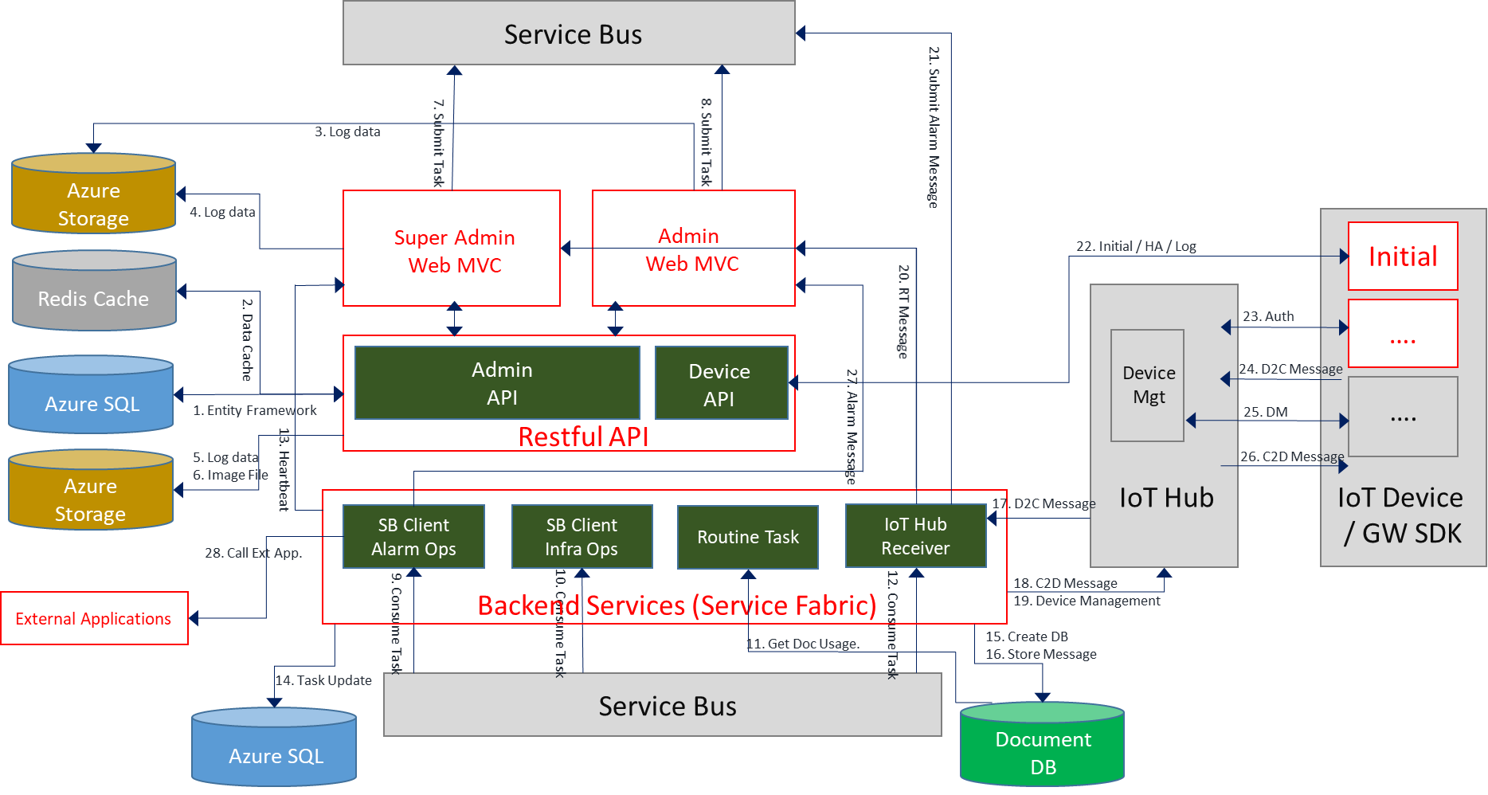
Architecture

Slide 3

Service Fabric: A Microservices Platform
Build Applications with many Languages, Frameworks, & Runtimes
Service Fabric: Microservices Platform
LifecycleMgmt
Independent Scaling
Rolling Upgrades
Always On Availability
Resource Efficient
Stateless/
Stateful
Public Clouds
On Premises
Private cloud
Developer

Slide 4
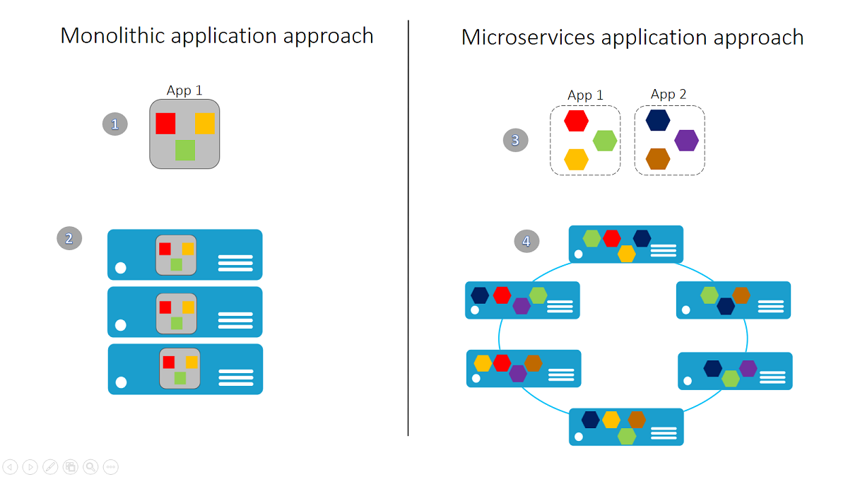

Slide 5
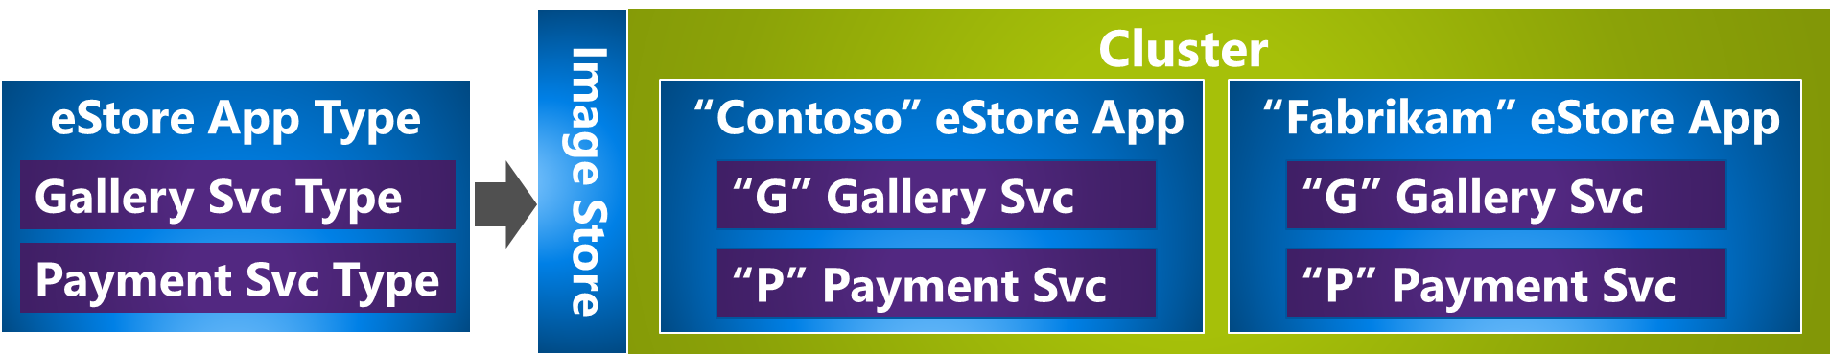
Application Concepts
Application
Application Type
Application Package.
Named Application
Service
Service Type
- Stateless
- Stateful
Service Package
Named Service
https://docs.microsoft.com/en-us/azure/service-fabric/service-fabric-technical-overview

Slide 6
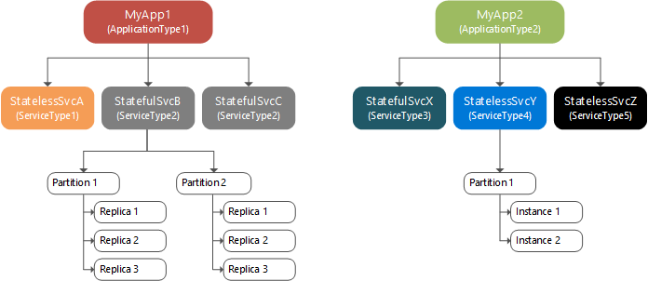
Stateless and Stateful in Service Fabric
Stateless
Can store persistent state in an external storage service such as Azure Storage, Azure SQL Database, or Azure Cosmos DB. Use a stateless service when the service has no persistent storage at all.
Stateful
A Stateful service uses Service Fabric to manage your service's state via its Reliable Collections or Reliable Actors programming models.
https://docs.microsoft.com/en-us/azure/service-fabric/service-fabric-content-roadmap

Slide 7
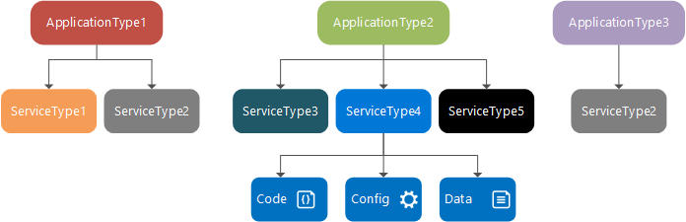
Application Concepts
Code Package
Guest Executables
Service Host Executables
Built-in programming models
Reliable Services
Reliable Actors
Notes:
Reliable Services: An API to build stateless and stateful services. Stateful service store their state in Reliable Collections (such as a dictionary or a queue). You also get to plug in various communication stacks such as Web API and Windows Communication Foundation (WCF).
Reliable Actors: An API to build stateless and stateful objects through the virtual Actor programming model. This model can be useful when you have lots of independent units of computation/state. Because this model uses a turn-based threading model, it is best to avoid code that calls out to other actors or services since an individual actor cannot process other incoming requests until all its outbound requests have completed.

Slide 8
Services we deployed in Connected Device Studio
Alarm Ops
Infra Ops
Routine Task
IoT Hub Receiver
Task | Application Type | Application | Instance | Service Type | Service Kind | Service | Code Package
Alarm Ops | SrvFabricType | SrvFabric | 2 | OpsAlarm Type | Stateless | OpsAlarm | Guest Executable
Infra Ops | SrvFabricType | SrvFabric | 2 | OpsInfra Type | Stateless | OpsInfra | Guest Executable
Routine Task | SrvFabricType | SrvFabric | 1 | RoutineTask ActorService Type | Stateful | RoutineTask ActorService | Reliable Actors
IoT Hub Receiver | SrvFabric IoTHubEventProcessor Type | IoTHubEP_XXXX (IoT Hub Alias) | 1 (Per IoT Hub Alias) | IoTHub EventProcessor Type | Stateless | IoTHub EventProcessor | Guest Executable
Notes:
Service Fabric – Stateful case

Slide 9
Deployment
ApplicationManifest.xml
Application Type
Application Type
SrvFabricIoTHubEventProcessorType
SrvFabricType
Application
Application
IoTHubEP_XXXX(IoT Hub Alias)
SrvFabric
Service Type
Service Type
IoTHubEventProcessorType
OpsAlarm
Type
OpsInfra
Type
RoutineTask
ActorService
Type
Service
Service
Service
Service
IoTHub
EventProcessor
OpsAlrm
OpsInfra
RoutineTask
ActorService
ServiceManifest.xml

Slide 10
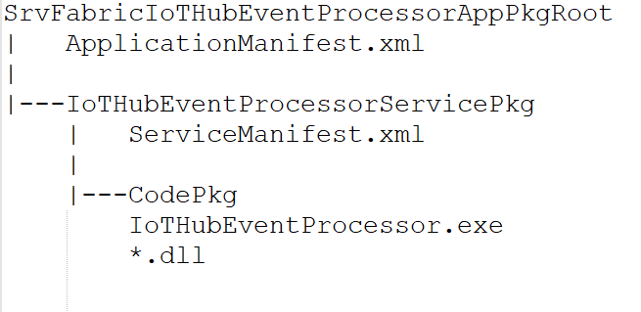
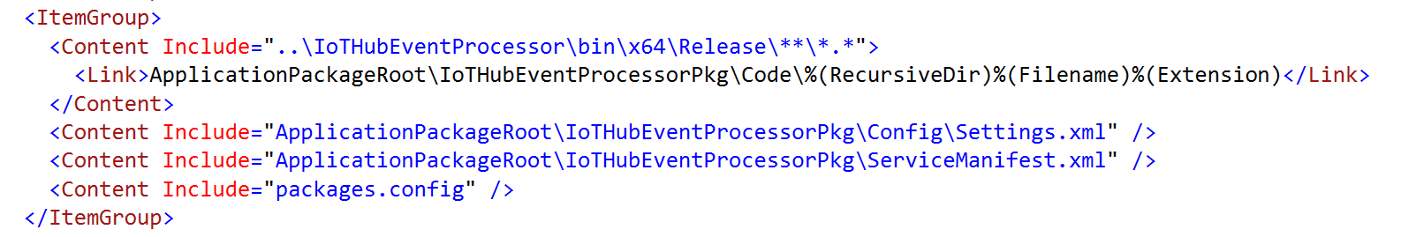
IoT Hub Event Processor App Pkg Dir & File
Defined in the .sfproj file
Notes:
sfproj. file

Slide 11
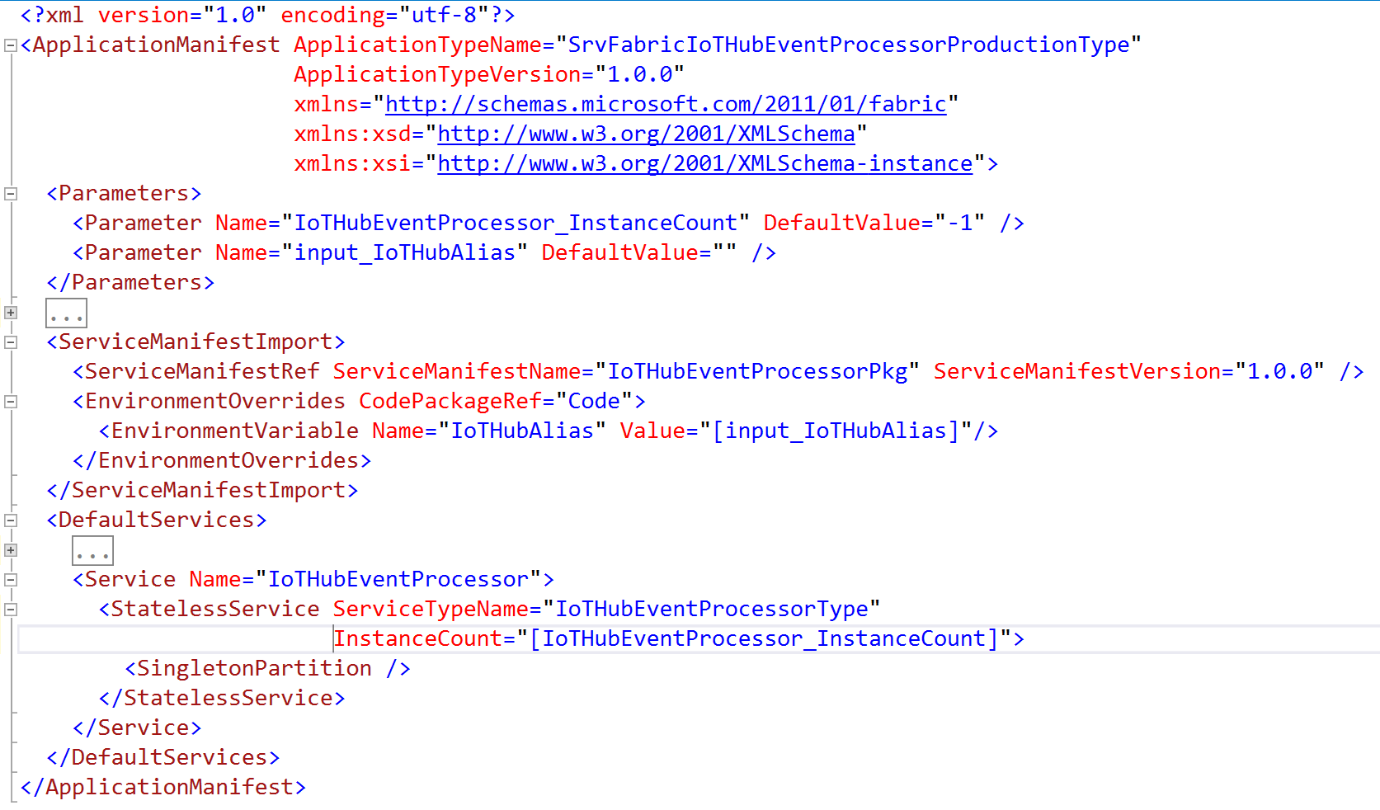
IoT Hub Event Processor’s ApplicationManifest.xml

Slide 12
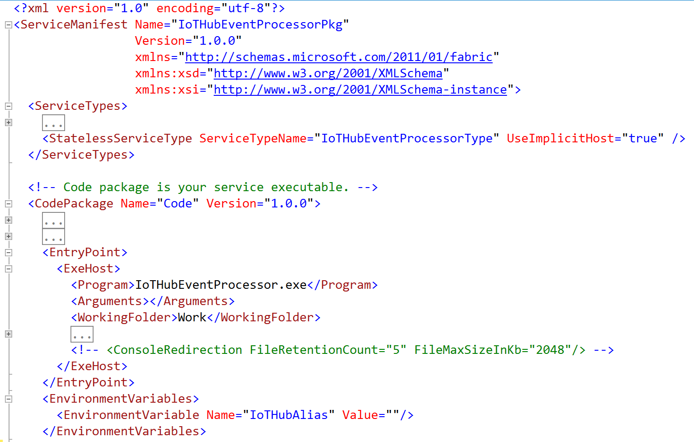
IoT Hub Event Processor’s ServiceManifest.xml

Slide 13
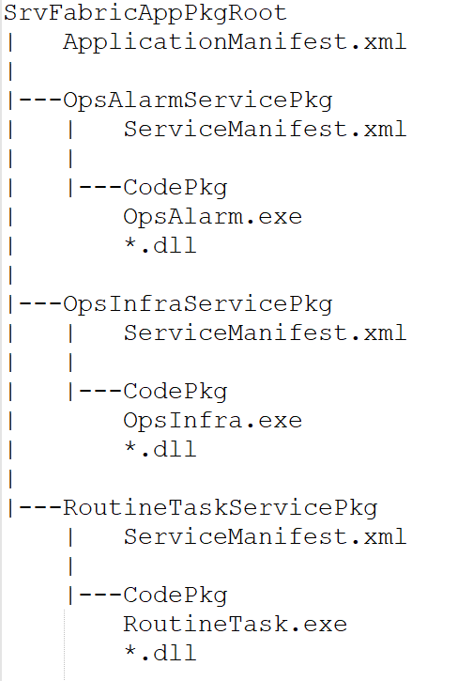
Service Fabric App Pkg Dir & File

Slide 14
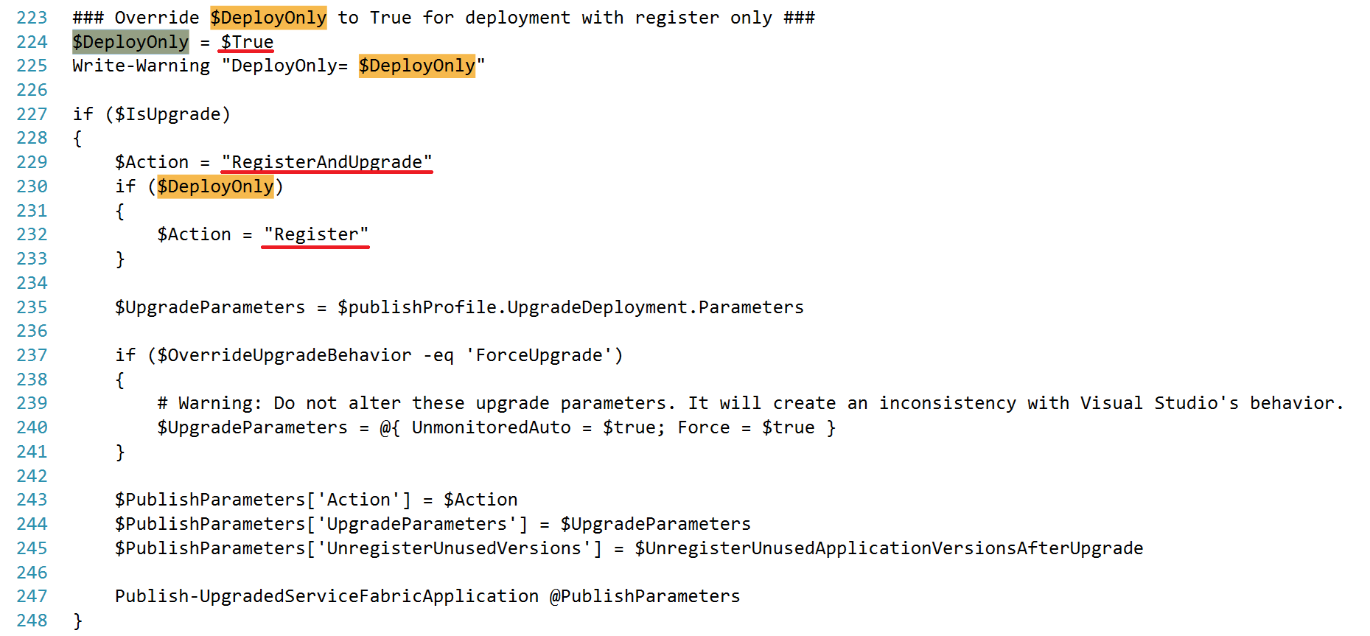
Rolling Upgrades without restart in IoT Hub Receiver
Modify the Deploy-FabricApplication.ps1 of Scripts for Deploy Only

Slide 15
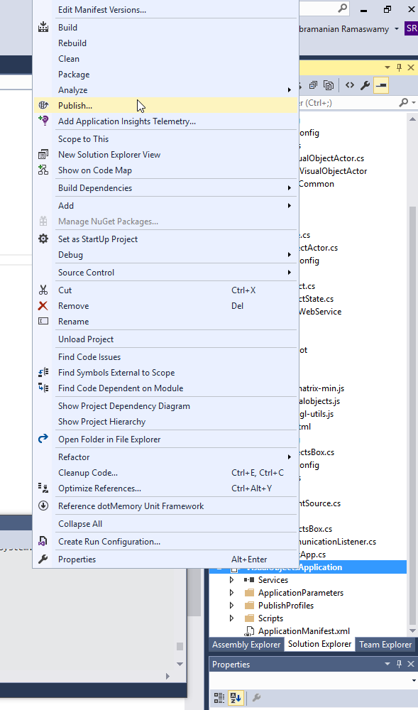
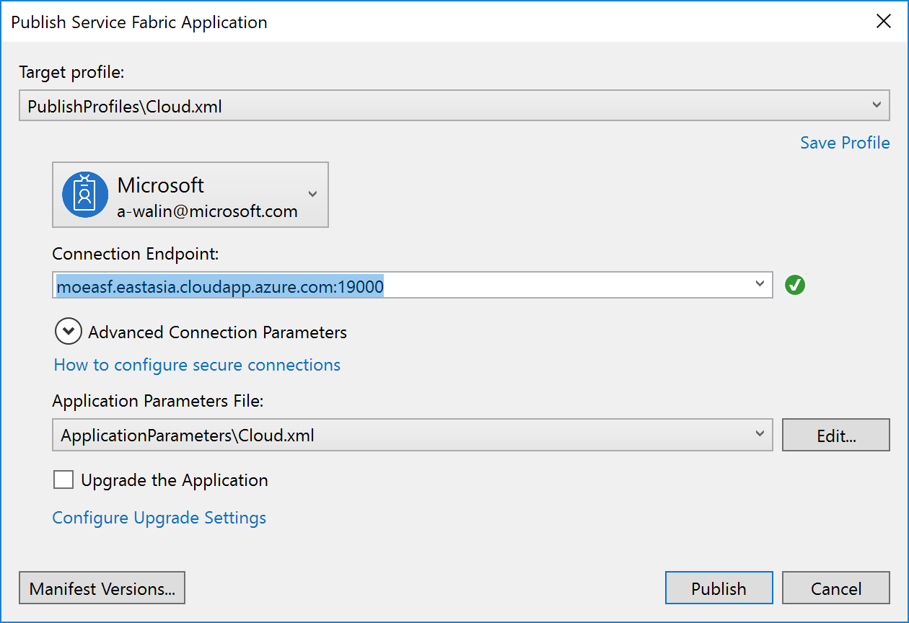
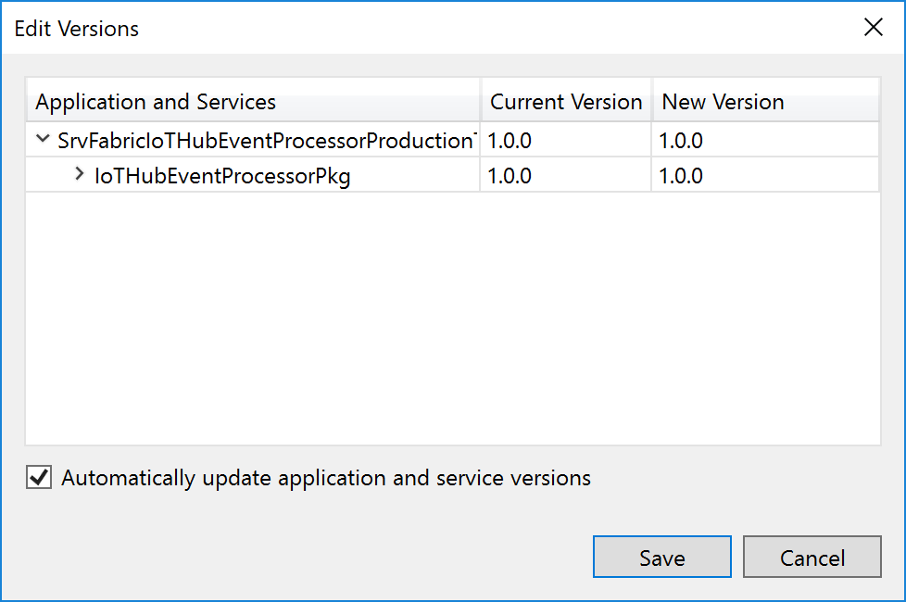
Publish
Right-Click
Select the Target Profile and Connection Endpoint
Check the Version

Slide 16
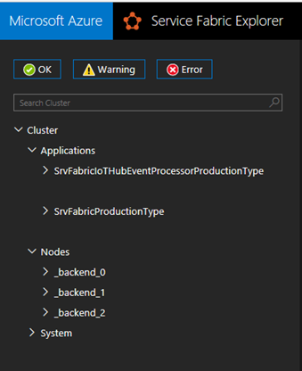
Service Fabric Explorer
2 Application Types for Production/Staging
SrvFabricIoTHubEventProcessorType
SrvFabricType
3 nodes (Default)

Slide 17
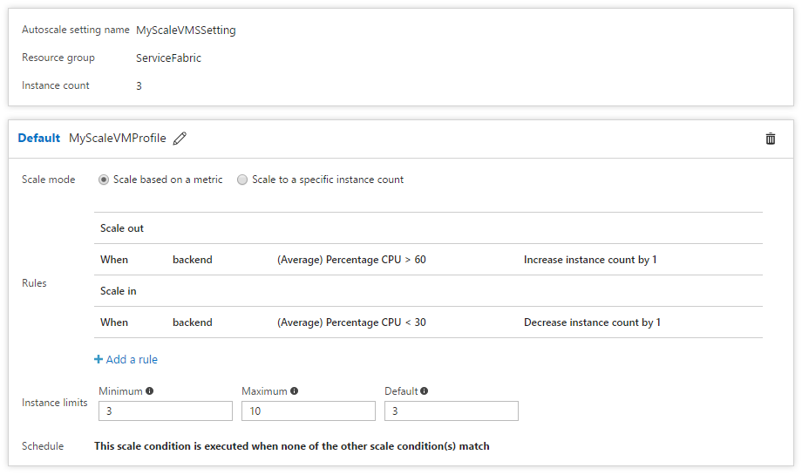
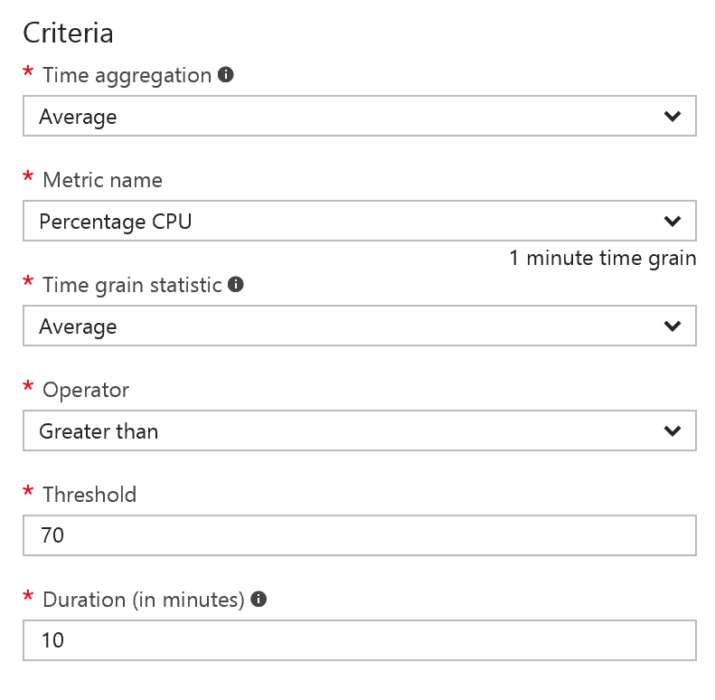
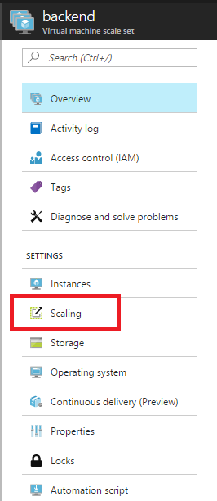
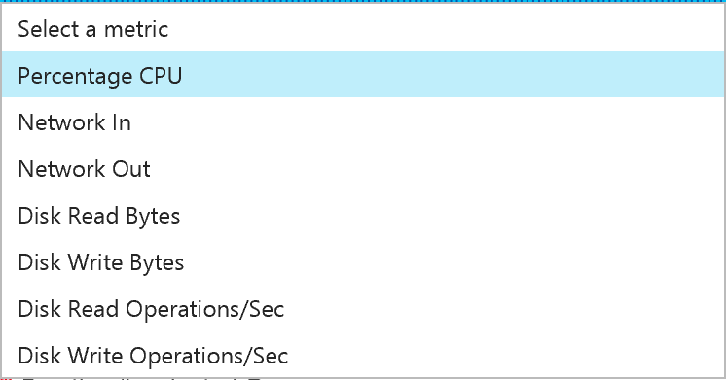
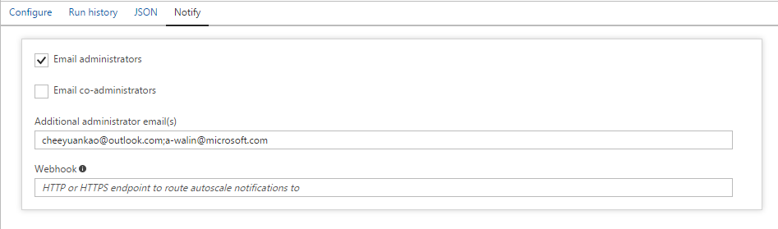
Scaling
Virtual machine scale set
Configure
Rule
Notify

Slide 18
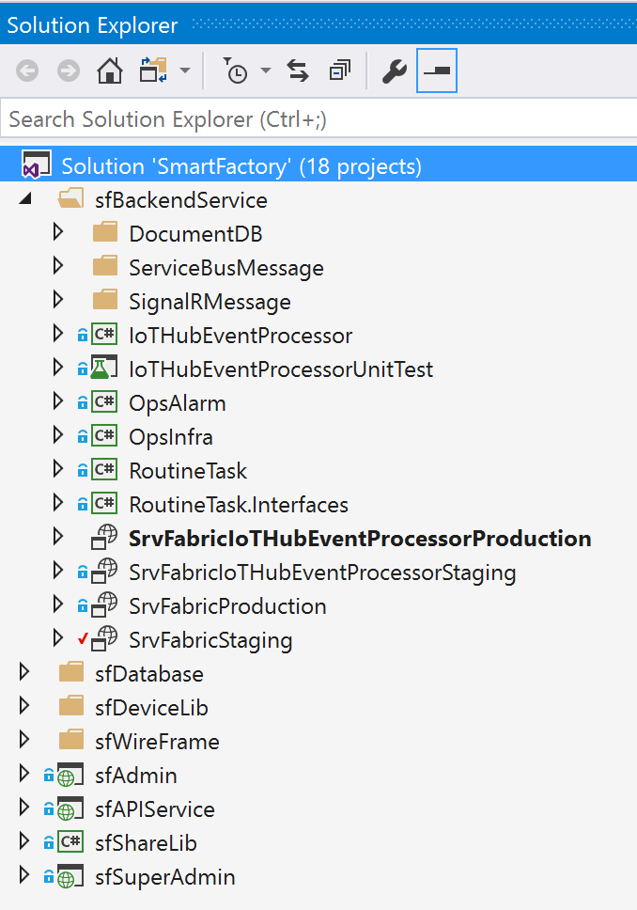
Project Structure
Folder: sfBackendService
2 Projects
SrvFabricIoTHubEventProcessorProduction: Service Fabric Application for IoT Hub Receiver
SrvFabricProduction : Service Fabric Application for Alarm Ops, Infra Ops and Routine Task

Slide 20
Upgrading a Named Application

Slide 21
Updating Your App’s Service’s Code
Put new code in code package
Update ver strings (#s are not required)
Copy new app package to image store
Register new app type/ version
Select named app(s) to upgrade to new version
<ApplicationManifest ApplicationTypeName="DemoAppType" ApplicationTypeVersion="3.0" ...>
<ServiceManifestImport>
<ServiceManifestRef ServiceManifestName="WebServer" ServiceManifestVersion="2.0" .../>
</ServiceManifestImport>
</ApplicationManifest>
C
B2
B1
<ServiceManifest Name="WebServer" Version="2.0">
<ServiceTypes>
<StatelessServiceType ServiceTypeName="WebServer" ...>
<Extensions> ... </Extensions>
</StatelessServiceType>
</ServiceTypes>
<CodePackage Name="CodePkg" Version="1.1">
<EntryPoint> ... </EntryPoint>
</CodePackage>
<Resources><Endpoints> ... </Endpoints></Resources>
</ServiceManifest>
A

Slide 22
Upgrade Domains
Prevent complete service outage while upgrading
More UDs → less loss of scale but more time to upgrade
# UD set when cluster created via cluster manifest; ARM template
Default=5; 20% down at a time
IMPORTANT: 2 versions of your code run side-by-side simultaneously
Beware of data/schema/protocol changes; use 2-phase upgrade
Below shows 9 instances spread across 5 UDs
UD #0
UD #1
UD #2
UD #3
UD #4
Instance-1
Instance-2
Instance-3
Instance-4
Instance-5
Instance-6
Instance-7
Instance-8
Instance-9

